Slide 1



Predator-Prey Interaction for Max-Min Ant System
Avery Li, Rem Turatbekov

Slide 2


Introduction
Max Min Ant Systems (MMAS)
Ant Colony Optimization (ACO)
Combinatorial and graph problems
TSP (traveling salesman problem)
Predator and prey
R

Slide 3

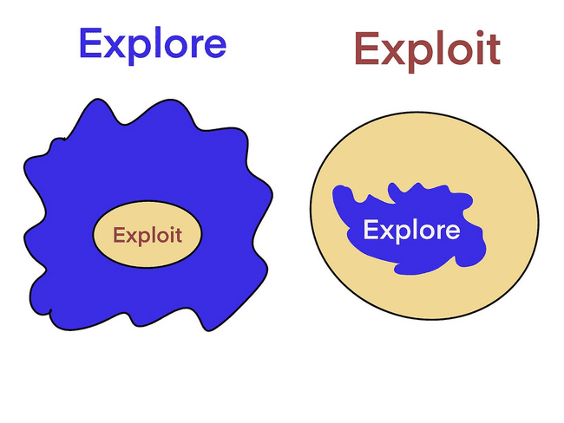
So what?
Random forest good but…
Overdependence on hyperparameters
Exploration vs exploitation
MMAS suffers from premature convergence
PP-MMAS will balance
Notes:
mine

Slide 4
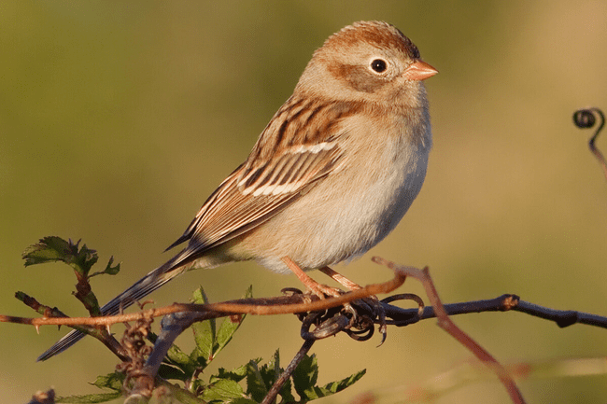
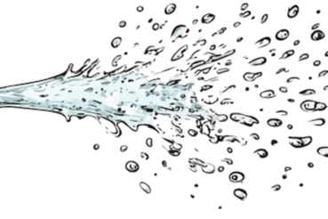
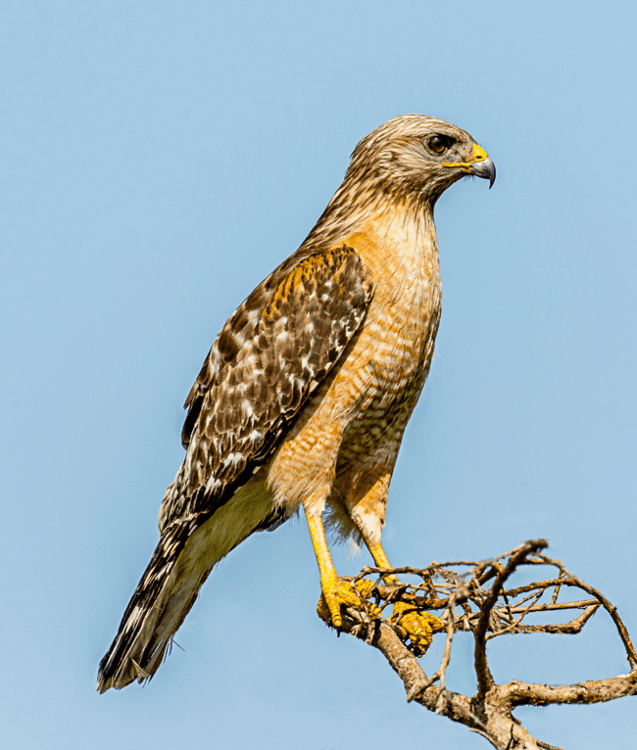
Has it been done before?
Nature-inspired algorithms
Sparrow Search
Harris Hawk (Tuah) Optimization
Ant colony optimizations?
CV edge detection
Efficacy of different ACOs
X-ray reconstruction
PP-MMAS is completely new!
TUAH!
R
Notes:
“Few but impactful”

Slide 5

Data
TSP samples from TSPLIB
Autism Dataset from Kaggle
800 labels - 639 neg, 161 pos
Removed: id, age, age_desc, contry_of_res, relation, result of AQ-10
Leaves: A1_Score, A2_Score, A3_Score, A4_Score, A5_Score, A6_Score, A7_Score A8_Score, A9_Score, A10_Score, gender, ethnicity, jaundice, autism, used_app_before
R

Slide 6


Random Forest
Random seed 42, trust
Ensemble learner
Decision trees
Hyperparameter space
num_attributes
num_sample
num_trees
max_depth
min_split
min_leaf
criterion
R

Slide 7
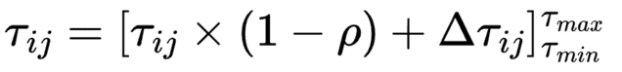

Max-Min Ant System
Ant system to focus on exploitation of search space
ACO: initialize swarm of ants, walk random paths, deposit pheromone
MMAS differs:
Bounds concentration of pheromone on trails
Updates pheromone along only iteration best path
PREMATURE CONVERGENCE
Notes:
mine

Slide 8

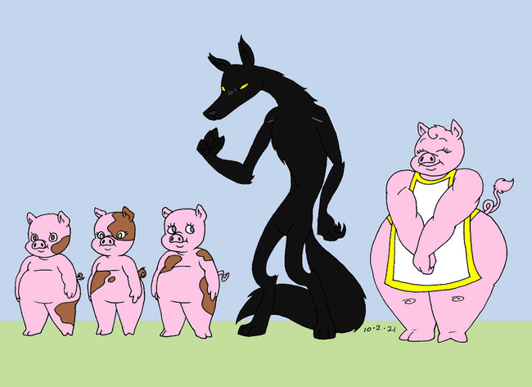
Predator Prey
Label proportion of N ants as prey ants
Predators choose paths based on amount of pheromone
Proportional probability that prey ant chooses path:
where η_{ij} is a measure of the heuristic function. In the case of the TSP, the heuristic is chosen as distance⁻¹ to encourage shorter paths, and used to aid both predators and prey in their search. β is a hyperparameter for the strength assigned to the heuristic function, P_{ij} denotes the number of predators that traversed a single edge, and ζ (zeta) is the proportion of predator ants.
yap
Notes:
mine

Slide 9
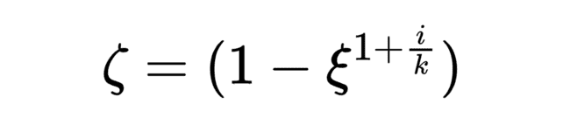
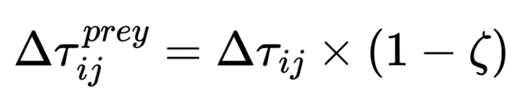
Predator Prey (cont.)
Prey population starts high, then decays exponentially
Best prey ant can deposit pheromone to induce predators to explore space
can be observed that even in the worst case, the system performs just as well as MMAS, since a proportion of the population (predator ants) act independently of the predator-prey interaction.
Notes:
mine

Slide 10

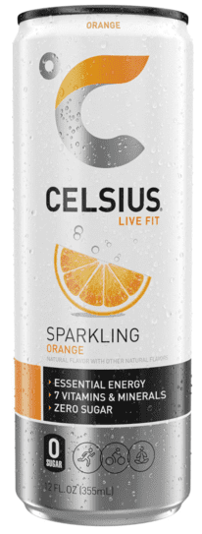
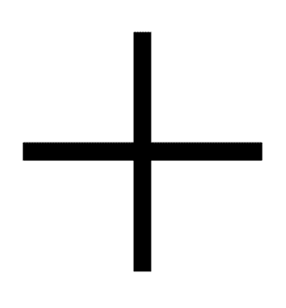
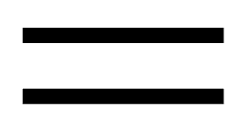

Hyperparameters
ρ: experimentally-determined optimum at 0.5
β: conservative value of 5
ξ: 0.7 to encourage high exploration
N: 100 for variability in search
PARAMETER
HYPERPARAMETER
R

Slide 11
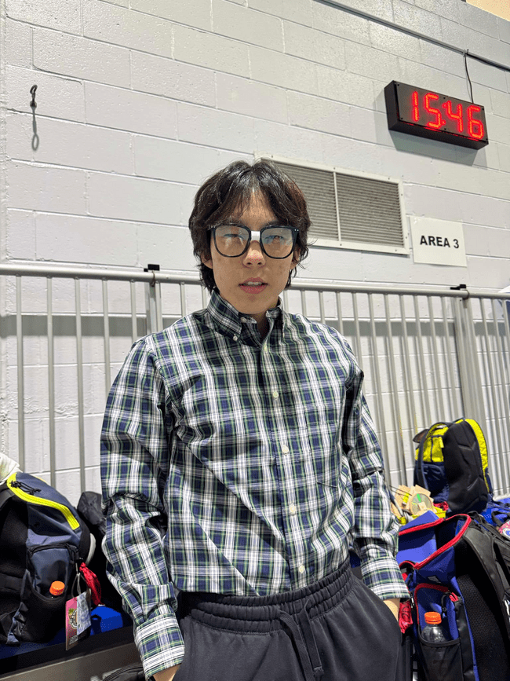
Metrics of Evaluation
PRC AUC, MCC
Imbalanced classes (80% to 20%)
Accuracy
General overview
According to my metrical evaluation…
R

Slide 12
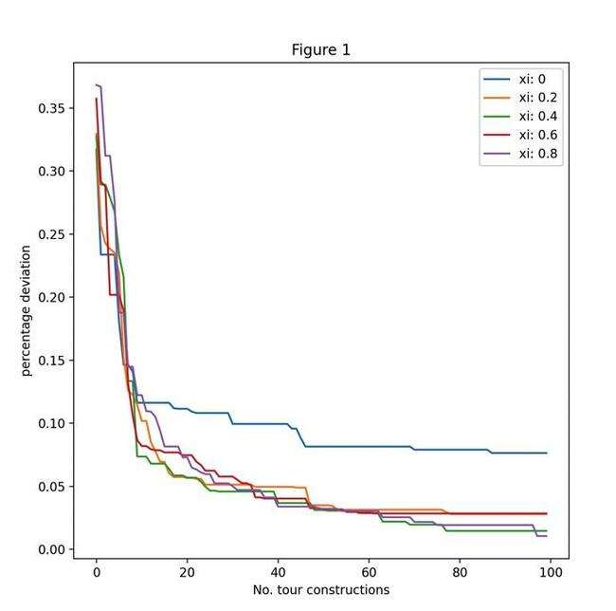
Results - Benchmark
PP-MMAS:
TSP_route opt_length dev_from_opt iterations
dantzig42 699 0 82
fri26 937 0 7
gr17 2085 0 5
kroA100 21321.79953 0.001890345991 308
att48 33614 0.001877738368 352
MMAS:
TSP_route opt_length dev_from_opt iterations
dantzig42 700 0.001430615165 53
fri26 937 0 40
gr17 2085 0 26
kroA100 21415.36532 0.006286910068 964
att48 33633 0.002444040416 111
R
Notes:
mine

Slide 13
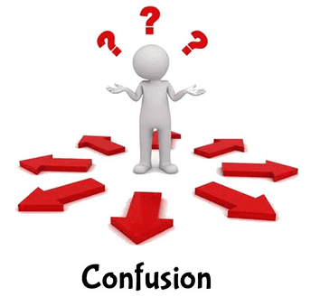
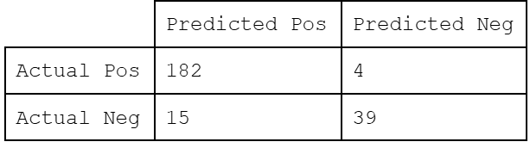
Results - Dataset
Model accuracy num_trees max_depth num_features max_samples criterion
1 0.92083 80 6 1 500 0
2 0.91667 115 5 1 260 2
3 0.91257 70 6 2 340 2
4 0.90833 135 2 5 130 2
5 0.90417 25 2 9 100 0
Choose model 1 for highest accuracy
Confusion matrix:
R

Slide 14


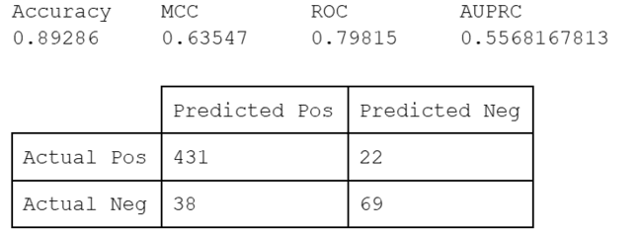

Overfitting???
TRAIN SET
Training results similar to test → not overfitting
TEST SET
R

Slide 15
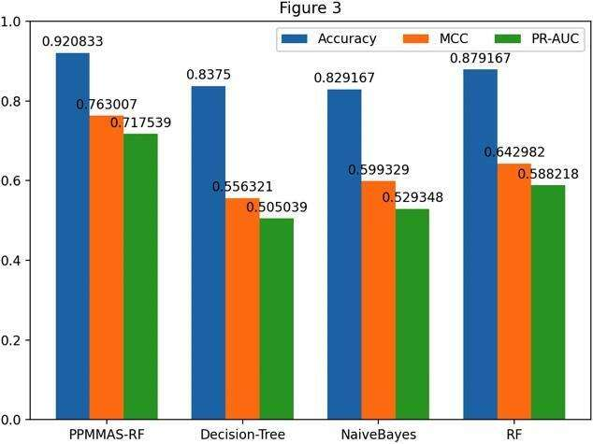
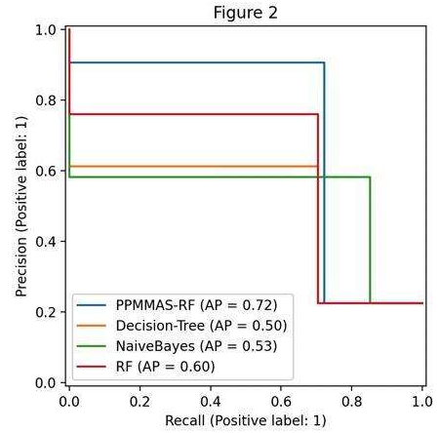
Result - Dataset (cont.)
Accuracy AUPRC MCC ROC
RF 0.89167 0.62377 0.67851 0.82497
RF_Selection 0.92083 0.71754 0.76301 0.85
NaiveBayes 0.83333 0.529 0.599 0.837
DecisionTree 0.84167 0.5168 0.57103 0.79928
R

Slide 16
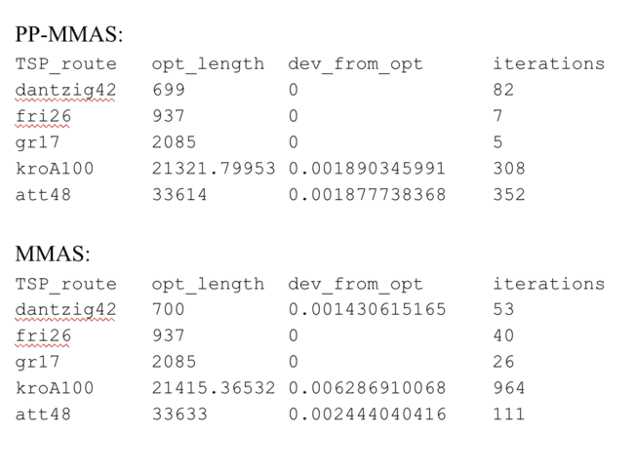
Analysis - Benchmarks
Both perform well on simple routes (gr17, fri26)
PP-MMAS converges with lower deviation for more complex routes
MMAS generally converges quicker on a less optimal solution
gets stuck in a local optimum and cannot escape due to lack of exploration
Notes:
mine

Slide 17
Analysis - xi
Higher value of xi = faster convergence
At xi = 0, PP-MMAS degenerates into pure MMAS
Convergence slowest
Notes:
mine

Slide 18

Analysis - Dataset
AUPRC
RF_Selection: 0.71754
RF: 0.62377
NaiveBayes: 0.529
DecisionTree: 0.5168
MCC
RF_Selection: 0.76301
RF: 0.67851
NaiveBayes: 0.599
DecisionTree: 0.57103
Accuracy
RF_Selection: 0.92083
RF: 0.89167
DecisionTree: 0.84167
NaiveBayes: 0.83333
PP-MMAS beats others
PP-MMAS
Others
R

Slide 19

Conclusion
PP-MMAS balances exploration/exploitation
Only did it for hyperparameter selection on RF
Use in other graph-type optimization problems
Image segmentation/thresholding
Control theory, optimize PID controller coefficients
Notes:
mine

Slide 20

Questions?

